Slide 1
Module: 4:
Lecture 1: Introduction to Learning

Slide 2
Learning
We describe agents that can improve their behavior through diligent study of past experiences and predictions about the future as learning agents.
An agent is learning if it improves its performance after making observations about the world.
When the agent is a computer, we call it machine learning.

Slide 3
Learning
A computer observes some data, builds a model based on the Machine learning data, and uses the model as both a hypothesis about the world and a piece of software that can solve problems.
The goals of learning are understanding and prediction.

Slide 4
Forms of Learning
Any component of an agent program can be improved by machine learning.
The improvements, and the techniques used to make them, depend on these factors:
Which component is to be improved.
What prior knowledge the agent has, which influences the model it builds.
What data and feedback on that data is available.

Slide 5
Forms of Learning
Which component is to be improved
direct mapping from conditions on the current state to actions
infer relevant properties of the world
results of possible actions
Action-value information
Goals that describe classes of states

Slide 6
Forms of Learning
What prior knowledge the agent already has.
Example: A knowledge base
What representation is used for the data and the component.
representations: propositional and first-order logical sentences
Bayesian networks for the inferential components
factored representation—a vector of attribute values—and outputs that can be either a continuous numerical value or a discrete value

Slide 7
Forms of Learning
What feedback is available to learn from :
Types of feedback that determine the three main types of learning
supervised learning the agent observes some example input–output pairs and learns a function that maps from input to output
In unsupervised learning the agent learns patterns in the input even though no explicit feedback is supplied
reinforcement learning the agent learns from a series of reinforcements—rewards or punishments. For example, at the end of a chess game the agent is told that it has won (a reward) or lost (a punishment).

Slide 8
Statistical learning
Statistical learning theory is a framework for machine learning drawing from the fields of statistics and functional analysis.
Statistical learning theory deals with the problem of finding a predictive function based on data.
Statistical learning theory has led to successful applications in fields such as computer vision, speech recognition, and bioinformatics.

Slide 9
Statistical learning
The goals of learning are understanding and prediction. Learning falls into many categories, including supervised learning, unsupervised learning, online learning, and reinforcement learning.
From the perspective of statistical learning theory, supervised learning is best understood.
Supervised learning involves learning from a training set of data.
Every point in the training is an input-output pair, where the input maps to an output.
The learning problem consists of inferring the function that map between the input and the output, such that the learned function can be used to predict the output from future input.

Slide 10
Module: 4:
Lecture 2: Supervised & Unsupervised Learning

Slide 11
Supervised learning
Supervised learning, as the name indicates, has the presence of a supervisor as a teacher. supervised learning is based on training
Basically supervised learning is when we teach or train the machine using data that is well labeled.
Which means some data is already tagged with the correct answer.
After that, the machine is provided with a new set of examples(data) so that the supervised learning algorithm analyses the training data(set of training examples) and produces a correct outcome from labeled data.

Slide 12
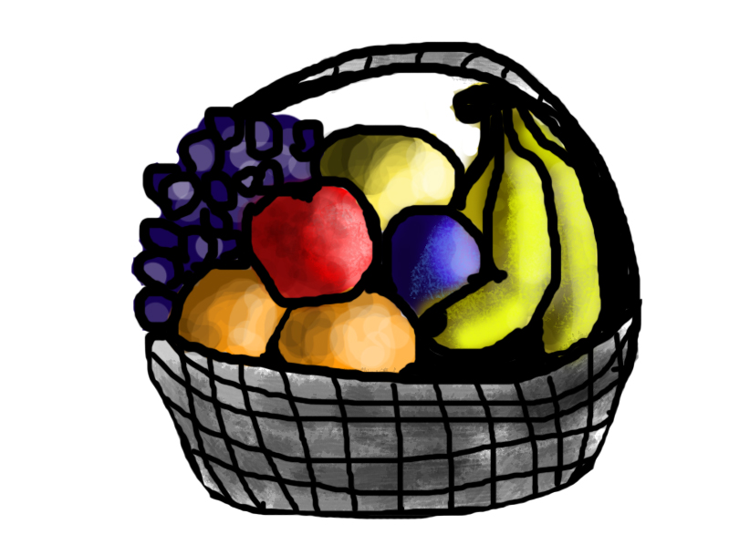

Supervised learning
For instance, suppose you are given a basket filled with different kinds of fruits.
Now the first step is to train the machine with all different fruits one by one like this:
If the shape of the object is rounded and has a depression at the top, is red in color, then it will be labeled as –Apple.
If the shape of the object is a long curving cylinder having Green-Yellow color, then it will be labeled as –Banana.
Now suppose after training the data, you have given a new separate fruit, from the basket, and asked to identify it.
You should return “Banana”.

Slide 13
Supervised learning
Supervised learning is classified into two categories of algorithms:
Classification: A classification problem is when the output variable is a category, such as “Red” or “blue” or “disease” and “no disease”.
Regression: A regression problem is when the output variable is a real value, such as “dollars” or “weight”.
Supervised learning deals with or learns with “labeled” data. This implies that some data is already tagged with the correct answer.
Types:- (Regression, Logistic Regression, Classification, Naive Bayes Classifiers, K-NN (k nearest neighbors), Decision Trees, Support Vector Machine)

Slide 14
Supervised learning
Advantages:-
Supervised learning allows collecting data and produces data output from previous experiences.
Helps to optimize performance criteria with the help of experience.
Supervised machine learning helps to solve various types of real-world computation problems.
Disadvantages:-
Classifying big data can be challenging.
Training for supervised learning needs a lot of computation time. So, it requires a lot of time.

Slide 15
Supervised learning
Regression models
Regression tasks are different, as they expect the model to produce a numerical relationship between the input and output data.
Examples of regression models include predicting real estate prices based on zip code, or predicting click rates in online ads in relation to time of day, or determining how much customers would be willing to pay for a certain product based on their age.

Slide 16
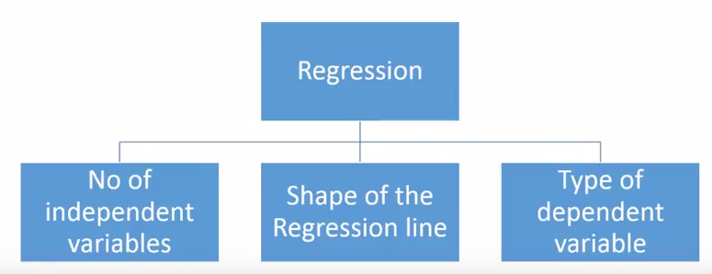
How many types of regression techniques do we have?
There are various kinds of regression techniques available to make predictions. These techniques are mostly driven by three metrics (number of independent variables, type of dependent variables and shape of regression line). We’ll discuss them in detail in the following sections.

Slide 17
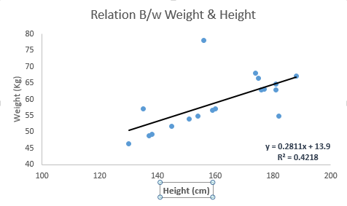
Linear Regression
It is one of the most widely known modeling technique. Linear regression is usually among the first few topics which people pick while learning predictive modeling. In this technique, the dependent variable is continuous, independent variable(s) can be continuous or discrete, and nature of regression line is linear.
Linear Regression establishes a relationship between dependent variable (Y) and one or more independent variables (X) using a best fit straight line (also known as regression line).
It is represented by an equation Y=a+b*X + e, where a is intercept, b is slope of the line and e is error term. This equation can be used to predict the value of target variable based on given predictor variable(s).
The difference between simple linear regression and multiple linear regression is that, multiple linear regression has (>1) independent variables, whereas simple linear regression has only 1 independent variable. Now, the question is “How do we obtain best fit line?”.

Slide 18
Supervised learning
Classification algorithms
An algorithm that maps the input data to a specific category.
A classification algorithm aims to sort inputs into a given number of categories or classes, based on the labeled data it was trained on.
Classification algorithms can be used for binary classifications such as filtering email into spam or non-spam and categorizing customer feedback as positive or negative.
Feature recognition, such as recognizing handwritten letters and numbers or classifying drugs into many different categories, is another classification problem solved by supervised learning.

Slide 19
Supervised learning
Types of Classifications
Binary Classification: Classification task with two possible outcomes.
Eg: Gender classification (Male / Female)
Multi-class classification: Classification with more than two classes. In multi class classification each sample is assigned to one and only one target label. Eg: An animal can be cat or dog but not both at the same time
Multi-label classification: Classification task where each sample is mapped to a set of target labels (more than one class). Eg: A news article can be about sports, a person, and location at the same time.

Slide 20
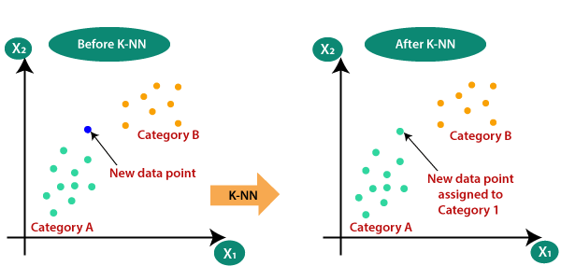
Supervised learning
K-Nearest Neighbor Algorithm
KNN works on the very same principle. It classifies the new data points depending upon the class of the majority of data points amongst the K neighbor, where K is the number of neighbors to be considered.
KNN captures the idea of similarity (sometimes called distance, proximity, or closeness) with some basic mathematical distance formulas like euclidean distance, Manhattan distance, etc.

Slide 21
Choosing the right value for K
To select the K that’s right for the data you want to train, run the KNN algorithm several times with different values of K and choose that value of K which reduces the number of errors on unseen data.
Pros:
KNN is simple and easiest to implement.
There’s no need to build a model, tuning several parameters, or make additional assumptions like some of the other classification algorithms.
It can be used for classification, regression, and search. So, it is flexible.
Cons:
The algorithm gets significantly slower as the number of examples and/or predictors/independent variables increase.

Slide 22
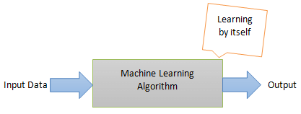
Unsupervised Learning
Unsupervised learning, on the other hand, is the method that trains machines to use data that is neither classified nor labeled. It means no training data can be provided and the machine is made to learn by itself. The machine must be able to classify the data without any prior information about the data.
The idea is to expose the machines to large volumes of varying data and allow it to learn from that data to provide insights that were previously unknown and to identify hidden patterns. As such, there aren’t necessarily defined outcomes from unsupervised learning algorithms. Rather, it determines what is different or interesting from the given dataset.
The machine needs to be programmed to learn by itself. The computer needs to understand and provide insights from both structured and unstructured data. Here’s an accurate illustration of unsupervised learning:

Slide 23

For instance, suppose it is given an image having both dogs and cats which it has never seen.
Thus the machine has no idea about the features of dogs and cats so we can’t categorize it as ‘dogs and cats ‘. But it can categorize them according to their similarities, patterns, and differences, i.e., we can easily categorize the above picture into two parts. The first may contain all pics having dogs in them and the second part may contain all pics having cats in them. Here you didn’t learn anything before, which means no training data or examples.
It allows the model to work on its own to discover patterns and information that was previously undetected. It mainly deals with unlabelled data.

Slide 24
Unsupervised Learning
Unsupervised Machine Learning Categorization
1) Clustering is one of the most common unsupervised learning methods. The method of clustering involves organizing unlabelled data into similar groups called clusters. Thus, a cluster is a collection of similar data items. The primary goal here is to find similarities in the data points and group similar data points into a cluster.
2) Association Association rules allow you to establish associations amongst data objects inside large databases. This unsupervised technique is about discovering interesting relationships between variables in large databases. For example, people that buy a new home most likely to buy new furniture.

Slide 25
Unsupervised Learning
Applications of Unsupervised Learning Algorithms
Some practical applications of unsupervised learning algorithms include:
Fraud detection
Malware detection
Identification of human errors during data entry
Conducting accurate basket analysis, etc.

